Slide 1


Phased CC Transformation v6
April 2, 2015

Slide 2
Chase CCB – Target State
Customer – Partner – Supplier Converged Access
MultiService Network Provider Access Cloud
DIGITAL
VOICE
Channels / Touch Points
Avaya Colllaboration Pods
Distributed across 4 Chase DC sites
SBC | GW
Avaya, Chase & 3rd Party
Omni-Channel CX Snap-Ins
Real-Time Context, Events
and Decisioning
Session, Application and Media Routing
SIP, Web, WebRTC
Avaya Engagement
Development Platform
System Management and Surveillance
Knowledge Centered Support
User Experience Servers
Common APIs: SIP, WebRTC, WS*, REST
Performance Management and Analytics
Avaya, Chase & 3rd Party
VXML Apps
Avaya Aura
Experience Portal
Avaya Aura
Communications Core
DIGITAL
VOICE
DIGITAL
VOICE
DIGITAL
VOICE
Servicing
Advisor
Virtual - AI
Legacy CCS Applications
Routing, MIS, Voice Recording, CRM, WFM, QM
Specialist
Specialist
Specialist

Slide 3
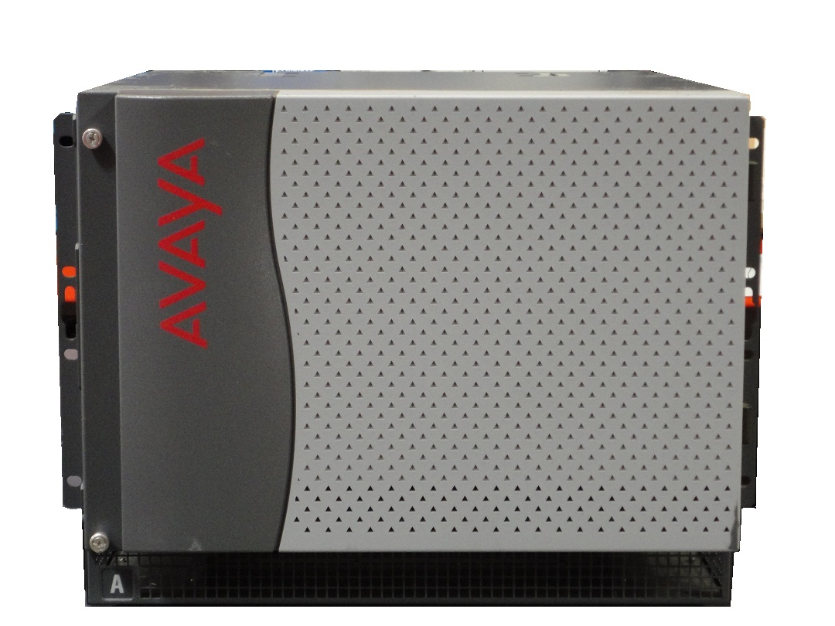
Chase CCB – Transform Phase 1.0
Customer – Partner – Supplier Converged Access
MultiService Network Provider Access Cloud
DIGITAL
VOICE
Channels / Touch Points
Avaya Colllaboration Pods
Distributed across 4 Chase DC sites
AS 5400 GW
Convergys
IVR/SN
Verizon
NGSN
Avaya, Chase & 3rd Party
Omni-Channel CX Snap-Ins
SBC
Genesys CIM
Real-Time Context
and Events
Carrier take back and transfer, pre-route
Avaya Engagement
Development Platform
SIP and Web RTC Session Routing
System Management and Surveillance
Common APIs: SIP, WebRTC, WS*, REST
Avaya, Chase & 3rd Party
VXML Apps
Avaya Aura
Experience Portal
CM Serving Sites (x 11) - 3 Triads
G.650 GW Clusters (9 x 58)
Avaya Aura Communications
Core (SM, MS)
CM-ELITE
CM-ELITE
CM-ELITE
CTI
VOICE
CTI
VOICE
CTI
VOICE
AES
T-Server
AES
T-Server
AES
T-Server
G.650’’s
NICE Speech Recording, QM, WFM
Chase 360 and Voice controls toolbar applications
CMS
Specialist
Specialist
Specialist
H.323 Media, Voice Tones, Announcements and Recording Streams

Slide 4




JPMC – Transform Phase 1.0
Legend:
Media RTP
Session Sig.
CTI/State events
TBnT
TBnT
HTTP
AS5400
Convergys
IVR/SN
Verizon
NGSN
SIP Trunk Routing
SM
Avaya Aura Session Managers Active - Active
1.1
SM
MS
Avaya Media Processors / Servers
Aura SIP Session / Application Routing
Nodal Routing Strategies
MS
AAEP
Avaya Aura Experience Portals
Active - Active
Genesys CIM
1.2
MIS Datamart
Elite
Elite
Elite
Avaya CM-Elite Cores 1-n
CMS
Control Manager
AES
AES
AES
Specialist Workspace
Cisco Unity VM
G650
T-Svr
T-Svr
T-Svr
Nice Recording
T-Lib / SDK
T-Lib / SDK
T-Lib / SDK
Media Anchoring & Voice Logger Streams
WFM,QM
Dialer

Slide 5
Chase CCB – Transform Phase 2.0
Customer – Partner – Supplier Converged Access
MultiService Network Provider Access Cloud
DIGITAL
VOICE
Channels / Touch Points
Avaya Colllaboration Pods
Distributed across 4 Chase DC sites
AS 5400 GW
Convergys
IVR/SN
Verizon
NGSN
Avaya, Chase & 3rd Party
Omni-Channel CX Snap-Ins
SBC
Avaya Context Store & Dynamic Routing
Genesys CIM
Real-Time Context
and Events
Carrier take back and transfer, pre-route
Avaya Engagement
Development Platform
SIP and Web RTC Session Routing
System Management and Surveillance
Common APIs: SIP, WebRTC, WS*, REST
User Experience Components (Java)
Avaya, Chase & 3rd Party
VXML Apps
Avaya Aura
Experience Portal
CM Serving Sites (x 4) - ESS
G.650 GW Clusters (9 x 58)
Avaya Aura Communications
Core (SM, MS, CM7.x)
CTI
VOICE
CTI
VOICE
CTI
VOICE
AES
T-Server
AES
T-Server
AES
T-Server
G.650’’s
NICE Speech Recording, QM, WFM
Chase 360 and Voice controls toolbar applications
CMS
Specialist
Specialist
Specialist
H.323 Media, Voice Tones, Announcements and Recording Streams
SIP & H.323 supported

Slide 6
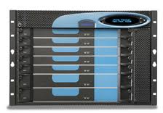
JPMC – Transform Phase 2.0
Legend:
Media RTP
Session Sig.
CTI/State events
TBnT
TBnT
HTTP
Phase out
SBCs
Convergys
IVR/SN
Verizon
NGSN
CS: Context Store Service Units
SIP Trunk Routing
SM
Avaya Aura Session Managers Active - Active
SM
CS
MS
Avaya Media Processors / Servers
CS
2.1
SIP Session / Application Routing
MS
AAEP
Avaya Aura Experience Portals
Nodal Routing Strategies
Genesys CIM
Avaya Experience Management Framework
CBA
2.5
Voice ID
MIS Datamart
Aura Sequenced Apps
Elite
Elite
Elite
Avaya CM-Elite Cores 1-n
CMS
Control Manager
AES
AES
AES
Specialist Workspace
Cisco Unity VM
T-Svr
T-Svr
T-Svr
SIP Recording
G650
T-Lib / SDK
T-Lib / SDK
T-Lib / SDK
WFM,QM
Media Anchoring & Voice Logger Streams
Dialer

Slide 7
Chase CCB – Transform Phase 3.0
Customer – Partner – Supplier Converged Access
MultiService Network Provider Access Cloud
DIGITAL
VOICE
Channels / Touch Points
Avaya Colllaboration Pods
Distributed across 4 Chase DC sites
SBC | GW
Convergys
IVR/SN
Verizon
NGSN
Avaya, Chase & 3rd Party
Omni-Channel CX Snap-Ins
Avaya Context Store & Dynamic Routing w/WA
URS Database
Real-Time Context
and Events
SIP Refer w/ Replaces
Avaya Engagement
Development Platform
SIP and Web RTC Session Routing
System Management and Surveillance
Knowledge Centered Support
Common APIs: SIP, WebRTC, WS*, REST
User Experience Components (Java)
Avaya, Chase & 3rd Party
VXML Apps
Avaya Aura
Experience Portal
CM Serving Sites (x 4) - ESS
G.650 GW Clusters (9 x 58)
Avaya Aura Communications
Core (SM, MS, CM7.x)
CTI
VOICE
CTI
VOICE
CTI
VOICE
AES
T-Server
AES
T-Server
AES
T-Server
G.650’’s
NICE Speech Recording, QM, WFM
Chase 360 and Voice controls toolbar applications
CMS
Specialist
Specialist
Specialist
H.323 Media, Voice Tones, Announcements and Recording Streams
SIP & H.323 supported

Slide 8
JPMC – Transform Phase 3.0
Legend:
Media RTP
Session Sig.
CTI/State events
TBnT
TBnT
HTTP
Phase out
SBCs
Convergys
IVR/SN
Verizon
NGSN
CS: Context Store
PC: Performance Center
WA: Work Assignment
SIP Trunk Routing
SM
Avaya Aura Session Managers Active - Active
SM
CS
WA
MS
Avaya Media Processors / Servers
CS
PC
WA
SIP Session / Application Routing
PC
3.6
Avaya Aura Experience Portals
3.1
AAEP
Nodal Routing Strategies
Genesys CIM
MS
Avaya Experience Management Multichannel
CBA
POM
3.5
Voice ID
MIS Datamart
Aura Sequenced Apps
Elite
Elite
Elite
Avaya CM-Elite Cores 1-n
AMS MSML GW support
CMS
Control Manager
3.3
CRM
Specialist Workspace
SIP Recording
3.4
T-Lib / SDK
T-Lib / SDK
T-Lib / SDK
WFM,QM
Dialer
Cisco Unity VM

Slide 9
Chase CCB – Transform Phase 4.0
Customer – Partner – Supplier Converged Access
MultiService Network Provider Access Cloud
DIGITAL
VOICE
Channels / Touch Points
Avaya Colllaboration Pods
Distributed across 4 Chase DC sites
SBC | GW
Avaya, Chase & 3rd Party
Omni-Channel CX Snap-Ins
Real-Time Context
and Events
Session, Application and Media Routing
SIP, Web, WebRTC
Avaya Engagement
Development Platform
System Management and Surveillance
Knowledge Centered Support
Common APIs: SIP, WebRTC, WS*, REST
User Experience Components (Java)
Avaya, Chase & 3rd Party
VXML Apps
Avaya Aura
Experience Portal
Avaya Aura Communications
Core (SM, MS, CM7.x)
DIGITAL
VOICE
DIGITAL
VOICE
DIGITAL
VOICE
NICE Speech Recording, QM, WFM
Servicing
Advisor
Virtual - AI
Chase 360 and Voice controls toolbar applications
CMS
Specialist
Specialist
Specialist
SIP & WebRTC supported

Slide 10
JPMC – Transform Phase 4.0
Avaya Media Servers managed in the Cloud
Legend:
MS
MS
Media RTP
Session Sig.
CTI/State events
TBnT
TBnT
HTTP
Phase out
CS: Context Store
PC: Performance Center
WA: Work Assignment (Attribute Matching)
SBCs
Convergys
IVR/SN
Verizon
NGSN
SIP Trunk Routing
SM
Avaya Aura Session Managers Active - Active
SM
CS
WA
MS
Avaya Media Processors / Servers
CS
PC
WA
SIP Session / Application Routing
PC
4.2
Avaya Aura Experience Portals
Nodal Routing Strategies
Genesys CIM
MS
AAEP
Avaya Experience Management Multichannel
CBA
Voice ID
MIS Datamart
Aura Sequenced Apps
3.1
Elite
Elite
Elite
Avaya CM-Elite Cores 1-n
AMS MSML GW support
3.2
CMS
3.3
Control Manager
3.4
CRM
Specialist Workspace
SGW
T-Lib / SDK
T-Lib / SDK
3.5
SIP Recording
Secure GW for Remote Agents
T-Lib / SDK
WFM,QM
Cisco Unity VM

Slide 11
Chase CCB – Target State
Customer – Partner – Supplier Converged Access
MultiService Network Provider Access Cloud
DIGITAL
VOICE
Channels / Touch Points
Avaya Colllaboration Pods
Distributed across 4 Chase DC sites
SBC | GW
Avaya, Chase & 3rd Party
Omni-Channel CX Snap-Ins
Real-Time Context, Events
and Decisioning
Session, Application and Media Routing
SIP, Web, WebRTC
Avaya Engagement
Development Platform
System Management and Surveillance
Knowledge Centered Support
User Experience Servers
Common APIs: SIP, WebRTC, WS*, REST
Performance Management and Analytics
Avaya, Chase & 3rd Party
VXML Apps
Avaya Aura
Experience Portal
Avaya Aura
Communications Core
DIGITAL
VOICE
DIGITAL
VOICE
DIGITAL
VOICE
Servicing
Advisor
Virtual - AI
Legacy CCS Applications
Routing, MIS, Voice Recording, CRM, WFM, QM
Specialist
Specialist
Specialist

